Slide 1
MAP REDUCE

Slide 2
MOTIVATION
◆ How to break up a large problem into smaller tasks, that can be
executed in parallel?
How to assign tasks to machines?
How to partition and distribute data?
How to share intermediate results?
How to coordinate synchronization, scheduling, fault-tolerance?

Slide 3
INTRODUCTION
◆ revolution is happening right now in computing.
◆ Most computers shipped today use multi-core microprocessors, i.e., chips with 2 (or 4, or 8, or more) separate processing units on the main microprocessor.
◆ As computing with multiple processors becomes widespread, though, we’re seeing a flowering of general-purpose software development tools tailored to multiple processor environments.

Slide 4
INTRODUCTION
◆ One of the organizations driving this shift is Google.
◆ Google is one of the largest users of multiple processor computing in the world, with its entire computing cluster containing hundreds of thousands of commodity machines, located in data centers around the world, and linked using commodity networking components.
◆ This approach to multiple processor computing is known as distributed computing;

Slide 5
INTRODUCTION
◆ MapReduce was introduced in a paper written in 2004 by Jeffrey Dean and
Sanjay Ghemawat from Google.
◆ What’s beautiful about MapReduce is that it makes parallelization almost entirely invisible to the programmer who is using MapReduce to develop applications.

Slide 6
INTRODUCTION
◆ MapReduce is the processing layer of Hadoop.
◆ MapReduce programming model is designed for processing large volumes of data in parallel by dividing the work into a set of independent tasks.
◆ Work (complete job) which is submitted by the user to master is divided into small works (tasks) and assigned to slaves.

Slide 7
INTRODUCTION
◆ A problem is divided into a large number of smaller problems each of which is
processed to give individual outputs.
◆ These individual outputs are further processed to give final output.

Slide 8
MapReduce Terminologies
◆ A Map-Reduce program will do this twice, using two different list processing
idioms-
◆ Map
◆ Reduce
◆ In between Map and Reduce, there is small phase called Shuffle and Sort in MapReduce.

Slide 9
MapReduce Terminologies : What is a MapReduce Job?
◆ MapReduce Job or a A “full program” is an execution of a Mapper and
Reducer across a data set.
◆ It is an execution of 2 processing layers i.e mapper and reducer.
◆ A MapReduce job is a work that the client wants to be performed.
◆ It consists of the input data, the MapReduce Program, and configuration info.

Slide 10
MapReduce Terminologies :What is Task in Map Reduce?
◆ A task in MapReduce is an execution of a Mapper or a Reducer on a slice of
data. It is also called Task-In-Progress.
◆ It means processing of data is in progress either on mapper or reducer.

Slide 11
MapReduce Terminologies :What is Task Attempt?
◆ Task Attempt is a particular instance of an attempt to execute a task on a
node.
◆ There is a possibility that anytime any machine can go down.
◆ For example, while processing data if any node goes down, framework reschedules the task to some other node.
◆ This rescheduling of the task cannot be infinite. There is an upper limit for
that as well. The default value of task attempt is 4.

Slide 12
Map Abstraction
◆ The map takes key/value pair as input.
◆ Whether data is in structured or unstructured format, framework converts the incoming data into key and value.
◆ Key is a reference to the input value.
◆ Value is the data set on which to operate.

Slide 13
Map Abstraction
◆ Map Processing:
◆ A function defined by user – user can write custom business logic according to his need to process the data.
◆ Applies to every value in value input.

Slide 14
Map Abstraction
◆ Map produces a new list of key/value pairs:
◆ An output of Map is called intermediate output.
◆ Can be the different type from input pair.
◆ An output of map is stored on the local disk from where it is shuffled to reduce nodes.

Slide 15
Reduce Abstraction
◆ Reduce takes intermediate Key / Value pairs as input and processes the
output of the mapper.
◆ Usually, in the reducer, we do aggregation or summation sort of computation.
◆ Input given to reducer is generated by Map (intermediate output)
◆ Key / Value pairs provided to reduce are sorted by key.

Slide 16
Reduce Abstraction
◆ Reduce processing:
◆ A function defined by user – Here also user can write custom business logic and get the final output.
◆ Iterator supplies the values for a given key to the Reduce function.
◆ Reduce produces a final list of key/value pairs:
◆ An output of Reduce is called Final output.
◆ It can be a different type from input pair.
◆ An output of Reduce is stored in HDFS.

Slide 17
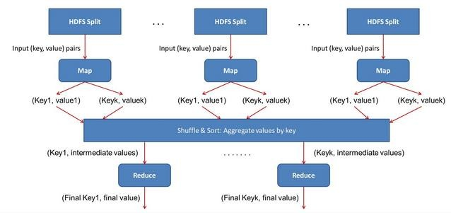
How Map and Reduce work Together?

Slide 18
How Map and Reduce work Together?
◆ Why there are more number of mappers as compared to number of reducers ?

Slide 19
How Map and Reduce work Together?
◆ Input data given to mapper is processed through user defined function
written at mapper.
◆ All the required complex business logic is implemented at the mapper level so that heavy processing is done by the mapper in parallel as the number of mappers is much more than the number of reducers.
◆ Mapper generates an output which is intermediate data and this output goes as input to reducer.

Slide 20
How Map and Reduce work Together?
◆ This intermediate result is then processed by user defined function written at
reducer and final output is generated.
◆ Usually, in reducer very light processing is done.
◆ This final output is stored in HDFS and replication is done as usual.

Slide 21
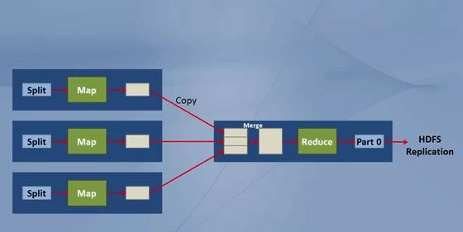
MapReduce DataFlow

Slide 22
MapReduce DataFlow
◆ There are 3 slaves in the figure.
◆ On all 3 slaves mappers will run, and then a reducer will run on any 1 of the slave.
◆ An input to a mapper is 1 block at a time. (Split = block by default)
◆ Mapper writes the output to the local disk of the machine it is working. This is the temporary data.
◆ An output of mapper is also called intermediate output.

Slide 23
MapReduce DataFlow
◆ movement of output from mapper node to reducer node is called shuffle.
◆ Map and reduce are the stages of processing.
◆ They run one after other.
◆ After all, mappers complete the processing, then only reducer starts processing.

Slide 24
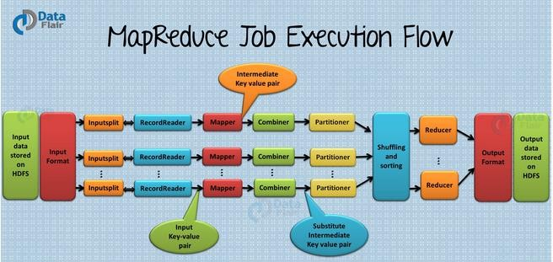
MapReduce DataFlow : Internal Working

Slide 25
MapReduce DataFlow : Internal Working
◆ There are various phases of MapReduce job execution such as Input Files, InputFormat in Hadoop, InputSplits, RecordReader, Mapper, Combiner, Partitioner, Shuffling and Sorting, Reducer, RecordWriter and OutputFormat.

Slide 26
MapReduce DataFlow : Internal Working
◆ The data for a MapReduce task is stored in input files, and input files
typically lives in HDFS.
◆ InputFormat defines how these input files are split and read.
◆ Input Splits is created by InputFormat, logically represent the data which will be processed by an individual Mapper. One map task is created for each split; thus the number of map tasks will be equal to the number of InputSplits.
◆ The split is divided into records and each record will be processed by the
mapper

Slide 27
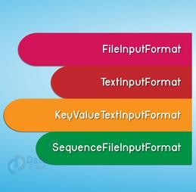

MapReduce DataFlow : Internal Working (Types of Input Format in Map Reduce)

Slide 28
MapReduce DataFlow : Internal Working
◆ Record Reader communicates with the InputSplit in Hadoop MapReduce and
converts the data into key-value pairs suitable for reading by the mapper.
◆ Mapper processes each input record (from RecordReader) and generates new key-value pair, and this key-value pair generated by Mapper is completely different from the input pair.
◆ The output of Mapper is also known as intermediate output which is written to the local disk.

Slide 29
MapReduce DataFlow : Internal Working
◆ The combiner is also known as ‘Mini-reducer’. Hadoop MapReduce Combiner performs local aggregation on the mappers’ output, which helps to minimize the data transfer between mapper and reducer.
◆ Hadoop MapReduce, Partitioner comes into the picture if we are working on more than one reducer (for one reducer partitioner is not used).
◆ According to the key value in MapReduce, each combiner output is partitioned, and a record having the same key value goes into the same partition, and then each partition is sent to a reducer.

Slide 30
MapReduce DataFlow : Internal Working
◆ the output is Shuffled to the reduce node (which is a normal slave node but reduce phase will run here hence called as reducer node). The shuffling is the physical movement of the data which is done over the network.
◆ Once all the mappers are finished and their output is shuffled on the reducer nodes, then this intermediate output is merged and sorted, which is then provided as input to reduce phase.
◆ Reducer takes the set of intermediate key-value pairs produced by the mappers as the input and then runs a reducer function on each of them to generate the output.

Slide 31
MapReduce DataFlow : Internal Working
◆ RecordWriter writes these output key-value pair from the Reducer phase to
the output files.
◆ The way these output key-value pairs are written in output files by RecordWriter is determined by the OutputFormat.

Slide 32
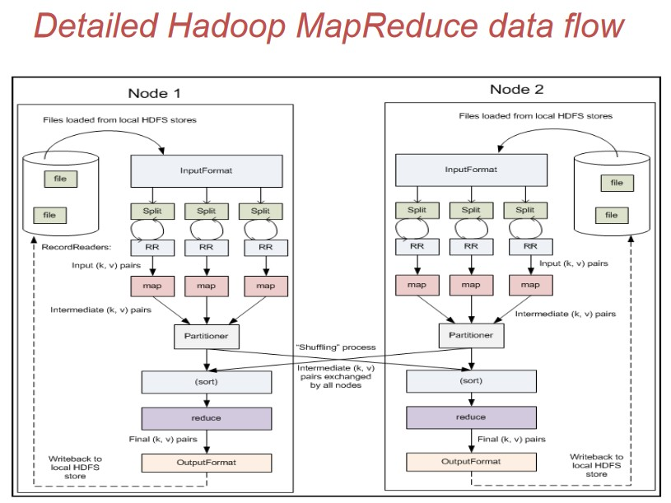
MapReduce DataFlow : Internal Working

Slide 33
Data Locality in MapReduce
◆ “Move computation close to the data rather than data to computation”. A computation requested by an application is much more efficient if it is executed near the data it operates on.
◆ This is especially true when the size of the data is very huge. This minimizes network congestion and increases the throughput of the system.
◆ Hadoop has come up with the most innovative principle of moving algorithm to data rather than data to algorithm. This is called data locality.

Slide 34
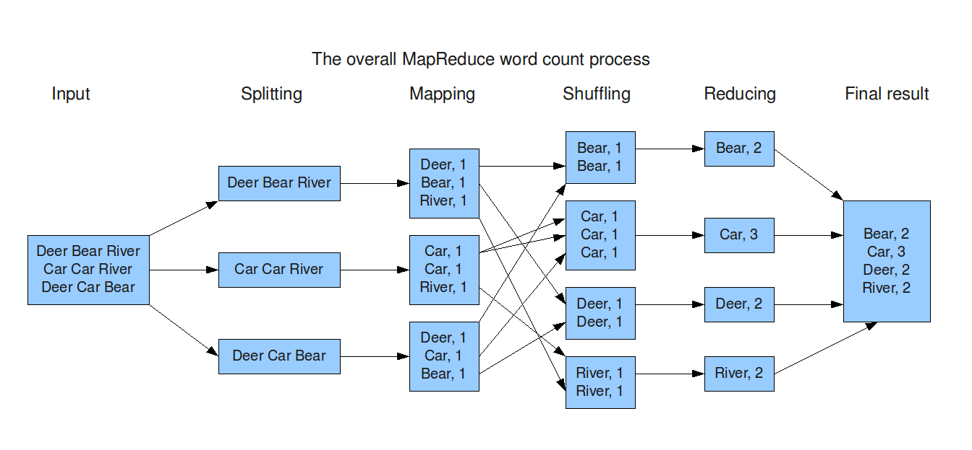
Example : Map Reduce (Word Count)

Slide 35
Example: Word Count (R)
◆ sentences<-scan("C:/Users/Amritpal/Desktop/tr.txt","character",sep="\n");
◆ sentences<-gsub("\\.","",sentences)
◆ sentences<-gsub("\\,","",sentences)
◆ words<-strsplit(sentences," ")
◆ words.freq<-table(words);
◆ cbind(names(words.freq),as.integer(words.freq))

Slide 36
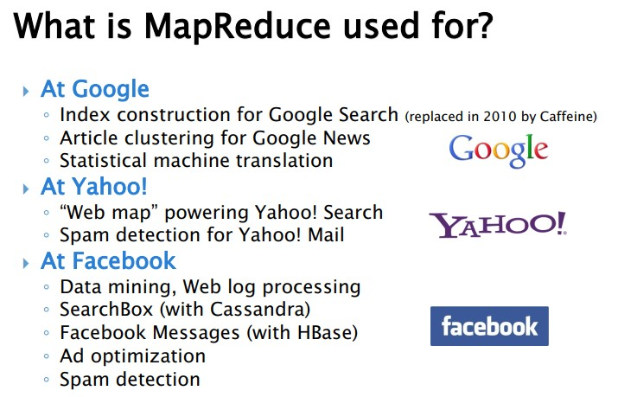
Applications

Slide 37
Map Reduce in R
◆ RMR package

Slide 38
Questions
◆ What is the fundamental difference between a MapReduce Split and a
HDFS block?
◆ MapReduce split is a logical piece of data fed to the mapper. It basically does not contain any data but is just a pointer to the data. HDFS block is a physical piece of data.
◆ When is it not recommended to use MapReduce paradigm for large scale data processing?
◆ It is not suggested to use MapReduce for iterative processing use cases, as it is
not cost effective, instead Apache Pig can be used for the same.

Slide 39
Questions
◆ What is the relationship between Job and Task in Hadoop?
◆ A single job can be broken down into one or many tasks in Hadoop.
◆ Is it important for Hadoop MapReduce jobs to be written in Java?
◆ It is not necessary to write Hadoop MapReduce jobs in Java but users can write MapReduce jobs in any desired programming language like Ruby, Perl, Python, R, etc. through the Hadoop Streaming API.

Slide 40
Questions
◆ For a job in Hadoop, is it possible to change the number of mappers to be
created?
◆ No, it is not possible to change the number of mappers to be created. The number of mappers is determined by the number of input splits.

Slide 41
MCQ’s
◆ What are supported programming languages for Map Reduce? | Hadoop
◆ A. The most common programming language is Java, but scripting languages are also supported via Hadoop streaming.
Any programming language that can comply with Map Reduce concept can be supported.
Only Java supported since Hadoop was written in Java.
Currently Map Reduce supports Java, C, C++ and COBOL.

Slide 42
MCQ’s
◆ What is the implementation language of the Hadoop MapReduce framework? |
Hadoop
◆ A. Java
C
FORTRAN
Python

Slide 43
MCQ’s
◆ How can you disable the reduce step? | Hadoop
◆ A. The Hadoop administrator has to set the number of the reducer slot to zero on all slave nodes. This will disable the reduce step.
It is imposible to disable the reduce step since it is critical part of the Mep-Reduce abstraction.
A developer can always set the number of the reducers to zero. That will completely disable the reduce step.
While you cannot completely disable reducers you can set output to one. There needs to be at least one reduce step in Map-Reduce abstraction.

Slide 44
MCQ’s
◆ Why would a developer create a map-reduce without the reduce step? |
Hadoop
◆ A. Developers should design Map-Reduce jobs without reducers only if no reduce slots are available on the cluster.
Developers should never design Map-Reduce jobs without reducers. An error will occur upon compile.
There is a CPU intensive step that occurs between the map and reduce steps. Disabling the reduce step speeds up data processing.
It is not possible to create a map-reduce job without at least one reduce step. A developer may decide to limit to one reducer for debugging purposes.

Slide 45
MCQ’s
◆ What is the default input format? | Hadoop
◆ A. The default input format is xml. Developer can specify other input formats as appropriate if xml is not the correct input.
There is no default input format. The input format always should be specified.
The default input format is a sequence file format. The data needs to be preprocessed before using the default input format.
The default input format is TextInputFormat with byte offset as a key and entire line as a value.

Slide 46
MCQ’s
◆ What happens if mapper output does not match reducer input? | Hadoop
◆ A. Hadoop API will convert the data to the type that is needed by the reducer.
Data input/output inconsistency cannot occur. A preliminary validation check is executed prior to the full execution of the job to ensure there is consistency.
The java compiler will report an error during compilation but the job will complete with exceptions.
A real-time exception will be thrown and map-reduce job will fail.

Slide 47
MCQ’s
◆ Which of the following is a valid flow in Hadoop ?
Input -> Reducer -> Mapper -> Combiner -> -> Output
Input -> Mapper -> Reducer -> Combiner -> Output
Input -> Mapper -> Combiner -> Reducer -> Output
Input -> Reducer -> Combiner -> Mapper -> Output

Slide 48
MCQ’s
◆ MapReduce was devised by ...
Apple
Google
Microsoft
Samsung

Slide 49
MCQ’s
◆ Which of the following is not an input format in Hadoop ?
TextInputFormat
ByteInputFormat
SequenceFileInputFormat
KeyValueInputFormat

Slide 50
TRUE/FALSE
◆ All MapReduce implementations implement exactly same algorithm.
◆ The answer is:
◆ False.
◆ For example, Google’s implementation does not allow change of key in the reducer, but provides sorting for values. Hadoop does not provide values sorting, but reducer can change the key.

Slide 51
TRUE/FALSE
◆ Each mapper must generate the same number of key/value pairs as its input
had.
◆ The answer is:
◆ False.
◆ Mapper may generate any number of key/value pairs (including zero).

Slide 52
TRUE/FALSE
◆ Mappers input key/value pairs are sorted by the key.
◆ The answer is:
◆ False.
◆ Mapper’s input is not sorted in any way.

Slide 53
TRUE/FALSE
◆ Mappers output key/value must be of the same type as its input.
◆ The answer is:
◆ False.
◆ Mapper may produce key/value pairs of any type.

